Slide 1
Secure D2D Aided Communication in Fog Computing

Slide 2
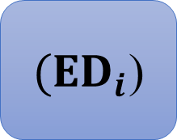
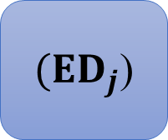
System Model
(CCS)
Website
Secure Channel
(NAD)
Network access device
${(ED}_{i}$)
D2D
${(ED}_{j}$)

Slide 3
Secret-Key based Secure Interaction Between Devices

Slide 4

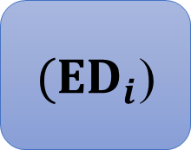


Assumption
(CCS)
Secure Channel
$$K_{{ec}_{i}}$$
$$K_{{ec}_{j}}$$
(NAD)
Insecure Wireless Comm.
Insecure Wireless Comm.
${(ED}_{i}$)
${(ED}_{j}$)
Insecure Wireless Comm.

Slide 5
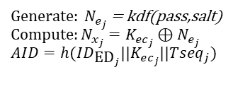
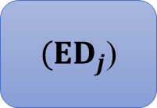

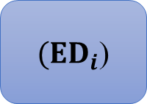
${(ED}_{i}$)
${(ED}_{j}$)
(NAD)
(CCS)
Secure Channel
$Generate​:N_{e_{i}}=kdf\left(pass,salt\right)$ $Compute:N_{x_{i}}=K_{ec_{i}}⊕N_{e_{i}}$ $$AID=h(ID_{\text{E}{\text{D}}_{i}}||K_{ec_{i}}||Tseq_{i})$$
$Generate:​ N_{e_{j}}$ = kdf(pass,salt) $$Compute:N_{x_{j}}=K_{ec_{j}}⊕N_{e_{j}} \\ AID=h(ID_{\text{E}{\text{D}}_{j}}||K_{ec_{j}}||Tseq_{j})$$
Secure D2D Communication Using CK

Slide 6
Public-Key based Secure Interaction Between Devices

Slide 7
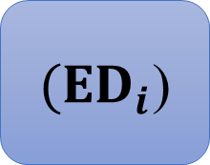
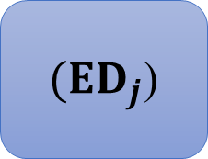


Assumption
(CCS)
Secure Channel
(NAD)
Application Server
Provide Public key of ${ED}_{j}$
Provide Public key of ${ED}_{i}$
Insecure Wireless Comm.
Insecure Wireless Comm.
${(ED}_{i}$)
${(ED}_{j}$)
Insecure Wireless Comm.

Slide 8
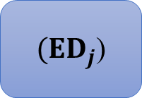

${(ED}_{i}$)
${(ED}_{j}$)
Secure D2D Communication Using

